Slide 1
(one-way) ANOVA
Compare means from 2 or more (independent) groups
Null hypothesis: means are the same.
Assumptions:
independent groups
sample of each group is normally distributed
sample of each group has same standart deviation
More conservative approach? Say we are not so sure about the assumptions

Slide 2
Real world example
Is the money that companies claimed from unemployment insurance during covid different by industry?

Slide 3
Conclusion from Notebook
In the first case, we compare the averages of three groups. These three groupes are defined as the first 10, next 10 and following 10 observations of setosa sepal leaf width. In this case, we obtain a p-value of 0.07, so with a 95% confidence interval we cannot reject the null hypothesis, so we can't reject the hypothesis that the means are equal. That's good news, because it means that probably, the width averages for setosa sepal leaves are equal.
In the second case, we compare the sepal leaf width averages of two Iris species, the average for setosa and the average for virginica. The p-value is very small, so we can conclude within a 95% confidence interval that null hypothesis can be rejected and therefore that it is more than likely that the two averages are different. This is shown in the following figures.

Slide 4
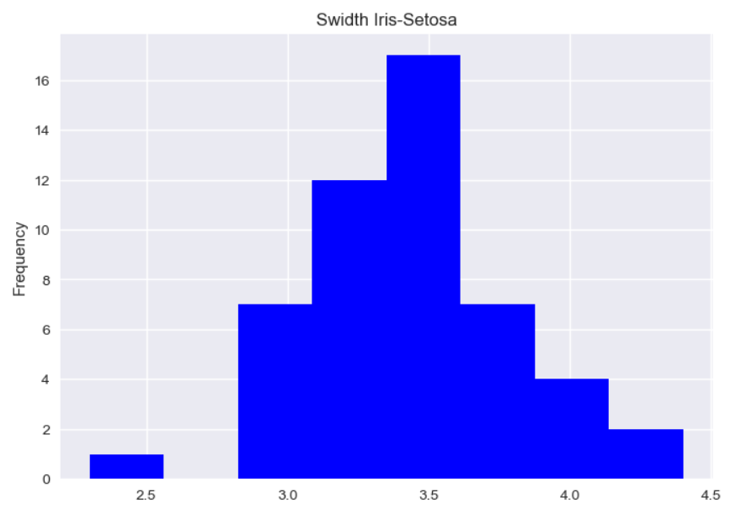
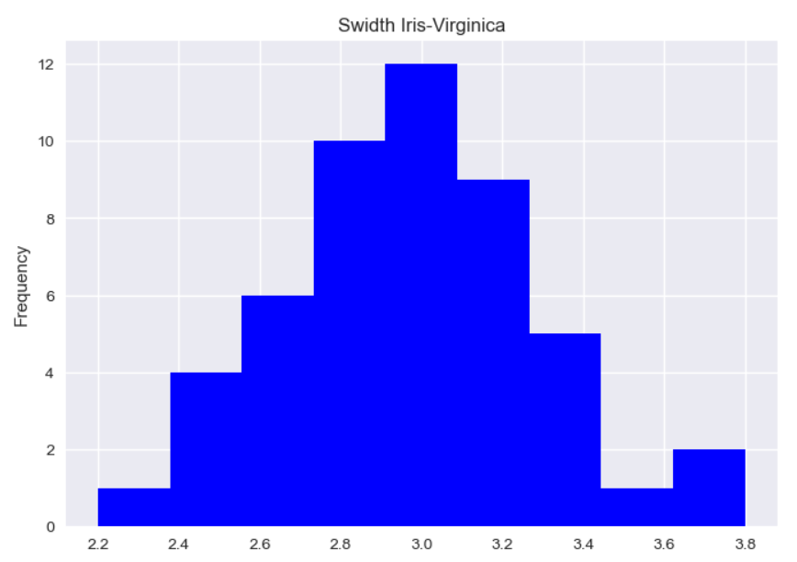
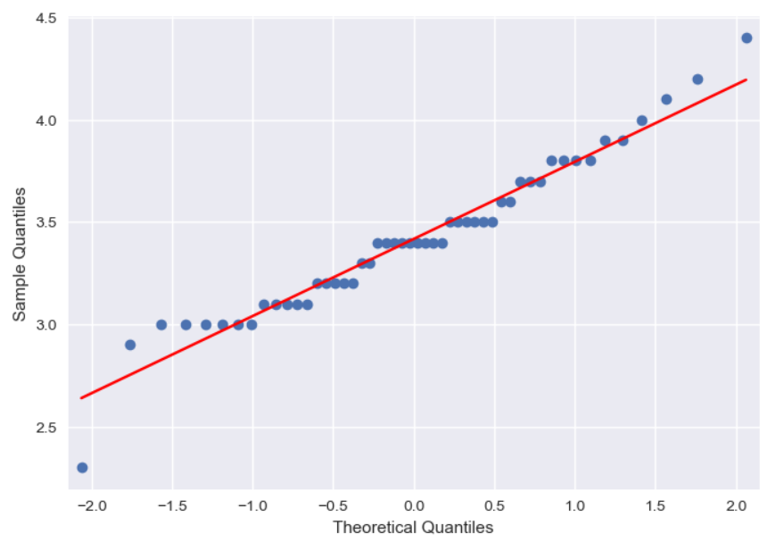
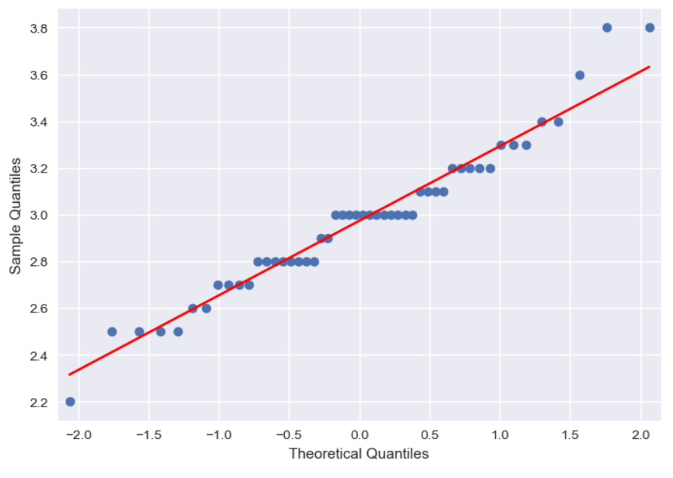
Setosa std: 0.37719490982779713
Virginica std: 0.319255383666431

Slide 5
